Slide 1
FoodHub Business Performance & Customer Insights Analysis Data Driven Business Insights
By Sarah Wolberg

Slide 2
Introduction
FoodHub is an online food delivery aggregator
Business goal: Improve demand understanding & operational efficiency
Data-driven analysis of 1,898 food orders

Slide 3
Context
The number of restaurants in New York is increasing day by day. Lots of students and busy professionals rely on those restaurants due to their hectic lifestyles. Online food delivery service is a great option for them. It provides them with good food from their favorite restaurants. A food aggregator company FoodHub offers access to multiple restaurants through a single smartphone app.
The app allows the restaurants to receive a direct online order from a customer. The app assigns a delivery person from the company to pick up the order after it is confirmed by the restaurant. The delivery person then uses the map to reach the restaurant and waits for the food package. Once the food package is handed over to the delivery person, he/she confirms the pick-up in the app and travels to the customer's location to deliver the food. The delivery person confirms the drop-off in the app after delivering the food package to the customer. The customer can rate the order in the app. The food aggregator earns money by collecting a fixed margin of the delivery order from the restaurants.

Slide 4
Objective
The food aggregator company has stored the data of the different orders made by the registered customers in their online portal. They want to analyze the data to get a fair idea about the demand of different restaurants which will help them in enhancing their customer experience. Suppose you are hired as a Data Scientist in this company and the Data Science team has shared some of the key questions that need to be answered. Perform the data analysis to find answers to these questions that will help the company to improve the business.

Slide 5
Data Description and Data Dictionary
Data Description
The data contains the different data related to a food order. The detailed data dictionary is given below.
Data Dictionary
order_id: Unique ID of the order
customer_id: ID of the customer who ordered the food
restaurant_name: Name of the restaurant
cuisine_type: Cuisine ordered by the customer
cost_of_the_order: Cost of the order
day_of_the_week: Indicates whether the order is placed on a weekday or weekend (The weekday is from Monday to Friday and the weekend is Saturday and Sunday)
rating: Rating given by the customer out of 5
food_preparation_time: Time (in minutes) taken by the restaurant to prepare the food. This is calculated by taking the difference between the timestamps of the restaurant's order confirmation and the delivery person's pick-up confirmation.
delivery_time: Time (in minutes) taken by the delivery person to deliver the food package. This is calculated by taking the difference between the timestamps of the delivery person's pick-up confirmation and drop-off information

Slide 6
Question 1: How many rows and columns are present in the data? [0.5 mark]
Dataset shape: 1,898 rows × 9 columns

Slide 7
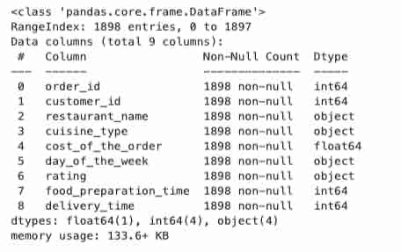
Question 2: What are the datatypes of the different columns in the dataset? [0.5 mark]
Key Points:
Total Orders: 1,898
Total Variables: 9
Memory Usage: 133.6 KB
Missing Values: None (complete dataset — no cleaning required)
Variable Types:
Numeric Variables (used for calculations):
order_id
customer_id
cost_of_the_order
food_preparation_time
delivery_time
Categorical Variables (text-based):
restaurant_name
cuisine_type
day_of_the_week
rating
Important Insight:
The rating column is stored as text (object type) because it contains the value “Not given”, meaning some customers did not provide feedback.

Slide 8
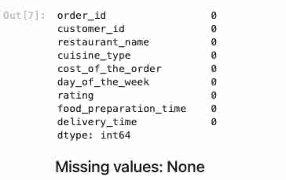
Question 3: Are there any missing values in the data? If yes, treat them using an appropriate method. [1 Mark]
There are no Missing values.

Slide 9
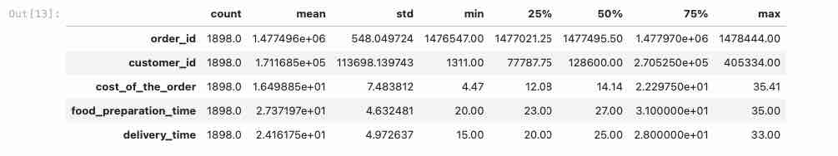

Question 4: Check the statistical summary of the data. What is the minimum, average, and maximum time it takes for food to be prepared once an order is placed? [2 marks]
The minimum food preparation time is 20 minutes, the average preparation time is approximately 27.37 minutes, and the maximum preparation time is 35 minutes. This indicates that most orders are prepared within a relatively narrow time range, suggesting consistent kitchen operations across restaurants.

Slide 10
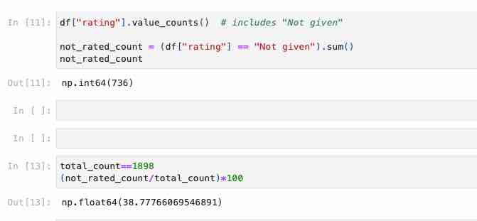
Question 5: How many orders are not rated? [1 mark]
Here this means that the total number of orders is 1898 and total orders not rated is 736 which is 38.8% of all orders. This indicates that a significant proportion of customers are not providing feedback, which can limit the company’s ability to assess customer satisfaction accurately.

Slide 11
Exploratory Data Analysis

Slide 12
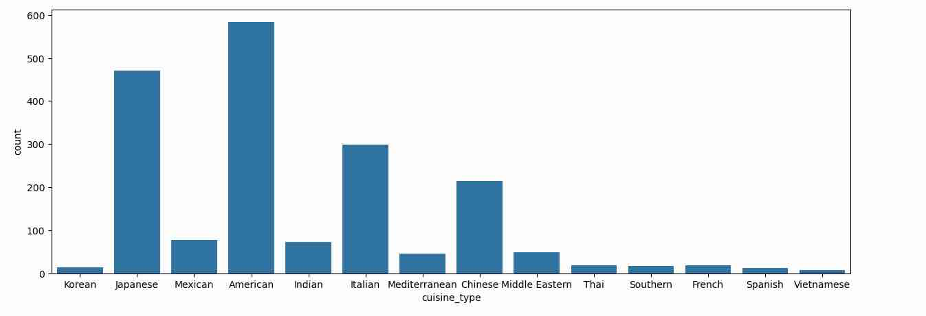
Question 6: Explore all the variables and provide observations on their distributions. (Generally, histograms, boxplots, countplots, etc. are used for univariate exploration.) [9 marks]
This tells us that there are 178 unique resturaunts. The market is fragmented. A few resturaunts may drive a large portion of the revenue.
This tells us that there are 178 unique resturaunts. The market is fragmented. A few resturaunts may drive a large portion of the revenue.
There are 1898 unique order IDs. This confirms that each row represents a unique order. No duplicate orders were detected in the data.
There are 1200 unique customers and 1898 orders. So some customers are have placed multiple orders. The Average orders per customer place are 1898/1200 = ~1.58 orders or 1.6 orders. However, this is a low repeat rate and this suggests that customer retention strategies could further improve from long term engagement.
There are 178 unique restaurants. The market is fragmented. A few restaurants may drive a large portion of the revenue.
There are also 14 cousine categories where American couisne is dominante with the highest count followed by Japenese and Italian Cuisines. Other cuisines such as Korean, Veitnamese, Southern, Thai, etc. have a lower demand presense. Overall, FoodHub demand is concentrated in a few coisines.

Slide 13
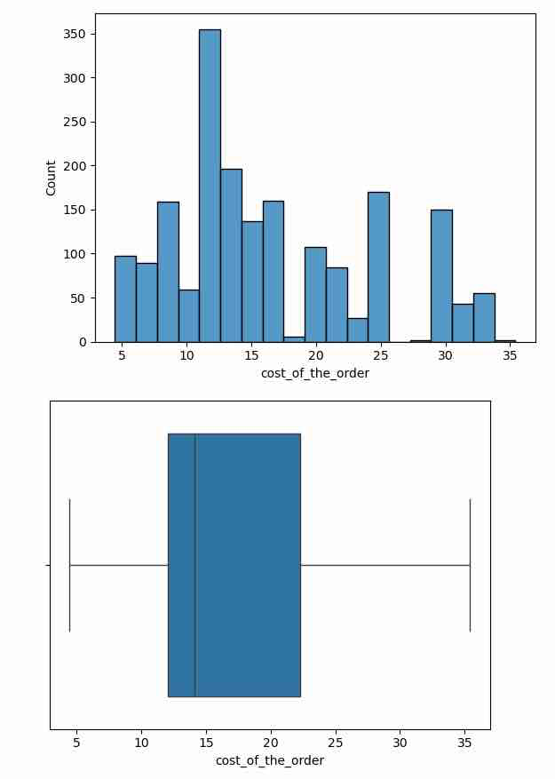
Cost of the Order
An observation here is that an order cost range is from 5 dollars to 35 dollars and most orders fall between 10and20. The distribution is slightly skewed to the right. Some higher cost orders or outliers are close to 30 dollars - 35 dollars .

Slide 14
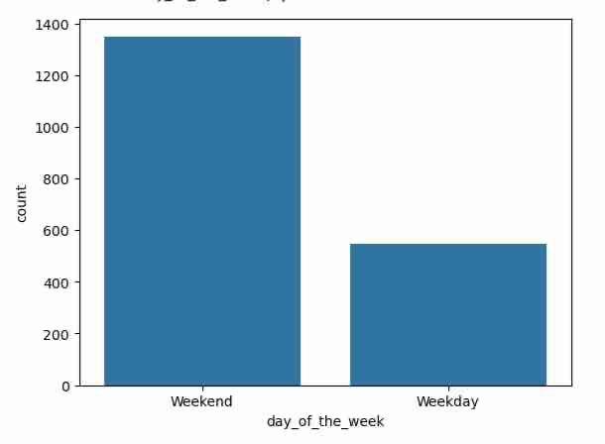

Day of the Week
What this is saying is that (1351/1898)100 =71% occur on weekends and (547/1898)100 =29% occurs on weekdays. Weekend demand is 1351/547 =2.4 times higher than weekday deman. This is a big difference in the number of orders received during the weekends and weekdays. This maybe due to customer behavior such as social gatherings (e.g. soccer games, birthday parties, work events), wanting to spend more time with familiy and less time cooking, etc. The operational impact to this is that Resturaunts will need to make sure to have enough staff on the weekends to handle increased worklowd, targeted market campaigns should happen mainly on weekends and be balanced on weekdays, restruants should be closed dates should be sometime during the week and not the weekend.

Slide 15
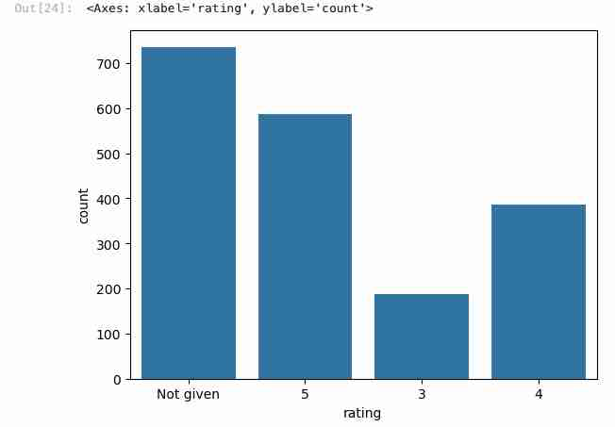
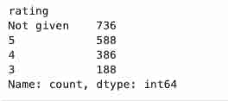
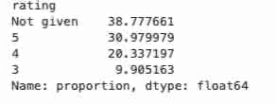
Rating
The rating distribution shows that 736 orders (38.8%) were not rated. Among the 1,162 rated orders, the majority received high ratings, with 588 (31%) rated 5 stars and 386 (20%) rated 4 stars. Only 188 (9.9%) received 3 stars, and no ratings of 1 or 2 were observed. This suggests strong overall customer satisfaction. However, the high percentage of unrated orders presents an opportunity for FoodHub to improve customer feedback participation through incentives or reminders.

Slide 16
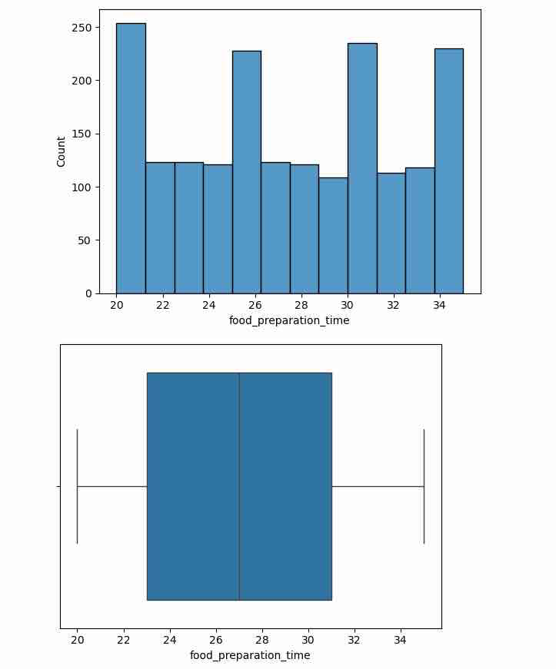
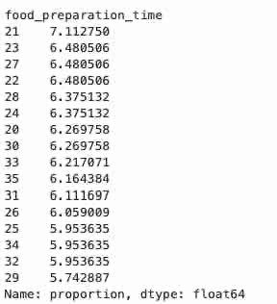
Food Preparation Time
The histogram and boxplot show that the minimum food prep time is 20 minutes and the maximum is 35 minutes. Most values are between 23 and 31 minutes, while the median is around 27 minutes. The distribution looks fairly symmetric with no extreme outliers.

Slide 17
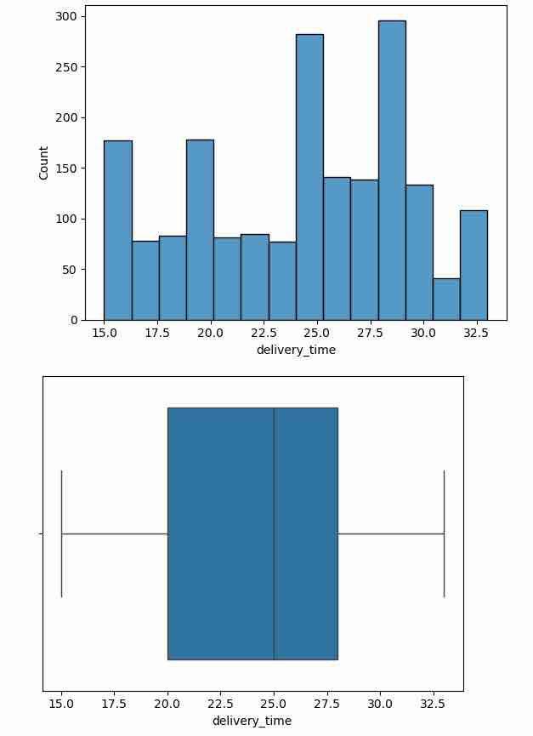
Delivery Time
Delivery time is moderately centered around 25-29 minutes. ther eis a slight skew to the right where we see some deliveries 31-33 minutes. Delivery time looks like it has more variability than prep time. Compared to food prep time, delivery time spreads more across bins, shows slightly more dispersion, and likely influenced by certain factors such as traffic, distance, or driver availabilty.

Slide 18
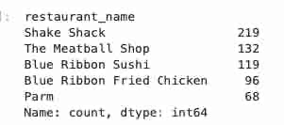
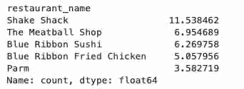
Question 7: Which are the top 5 restaurants in terms of the number of orders received? [1 mark]
The top 5 restaurants by number of orders are Shake Shack (219 or 11.5%), The Meatball Shop (132 or 6.95%), Blue Ribbon Sushi (119 or 6.27%), Blue Ribbon Fried Chicken (96 or 5.06%), and Parm (68 or 3.58%). Shake Shack leads significantly, accounting for approximately 11.5% of total orders. The distribution shows that demand is concentrated among a few high-performing restaurants. FoodHub may benefit from strengthening partnerships and promotional efforts with these top restaurants to maximize revenue and customer engagement.The top 5 restaurants contribute approximately one-third (~33–35%)of total orders, indicating that demand is concentrated among a small subset of restaurants. Shake Shack alone accounts for over 11% of total orders, highlighting its strong popularity among customers.

Slide 19
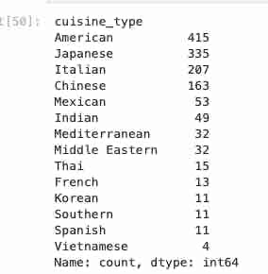
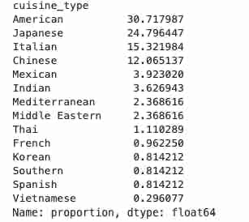
Question 8: Which is the most popular cuisine on weekends? [1 mark]
American cuisine is the most popular cuisine on weekends, accounting for 30.7% of weekend orders. Japanese cuisine follows closely at 24.8%. Together, these two cuisines account for over 55% of weekend demand. Additionally, the top four cuisines (American, Japanese, Italian, and Chinese) make up approximately 83% of total weekend orders, indicating strong demand concentration in a limited number of cuisine categories. FoodHub can leverage this insight by prioritizing promotions and partnerships within these high-demand cuisine segments during weekends.

Slide 20
Question 9: What percentage of the orders cost more than 20 dollars? [2 marks]
Out of 1,898 total orders, 555 orders (29.24%) cost more than 20 dollars. Which indicates that nearly one-third of customers place higher-value orders. While the majority of orders are priced at 20 dollars or below, the higher-priced segment represents a significant revenue opportunity, especially since the company earns a higher commission on orders above 20 dollars. Targeted promotions on premium meals could further increase overall profitability.

Slide 21
Question 10: What is the mean order delivery time? [1 mark]
The mean delivery time is 24.26 minutes, inticating that most deliveries are completed within approximately 25 minutes after pickup. When combined with the average food preparation time, customers receive their orders in roughly 50 minutes from placement. This suggests relatively efficient delivery operations; however, further optimization of delivery logistics could help reduce total service time and improve customer satisfaction.

Slide 22

Question 11: The company has decided to give 20% discount vouchers to the top 5 most frequent customers. Find the IDs of these customers and the number of orders they placed. [1 mark]
The top frequent customers are customer IDs 52832 (13 orders), 47440 (10 orders), and 83287 (9 orders). These customers exhibit significantly higher ordering frequency compared to the average of approximately 1.6 orders per customer. This indicates the presence of a loyal customer segment. Offering promotional discounts, loyalty rewards, or exclusive offers to these high-frequency customers could further strengthen retention and increase lifetime value.

Slide 23
Multivariate Analysis

Slide 24
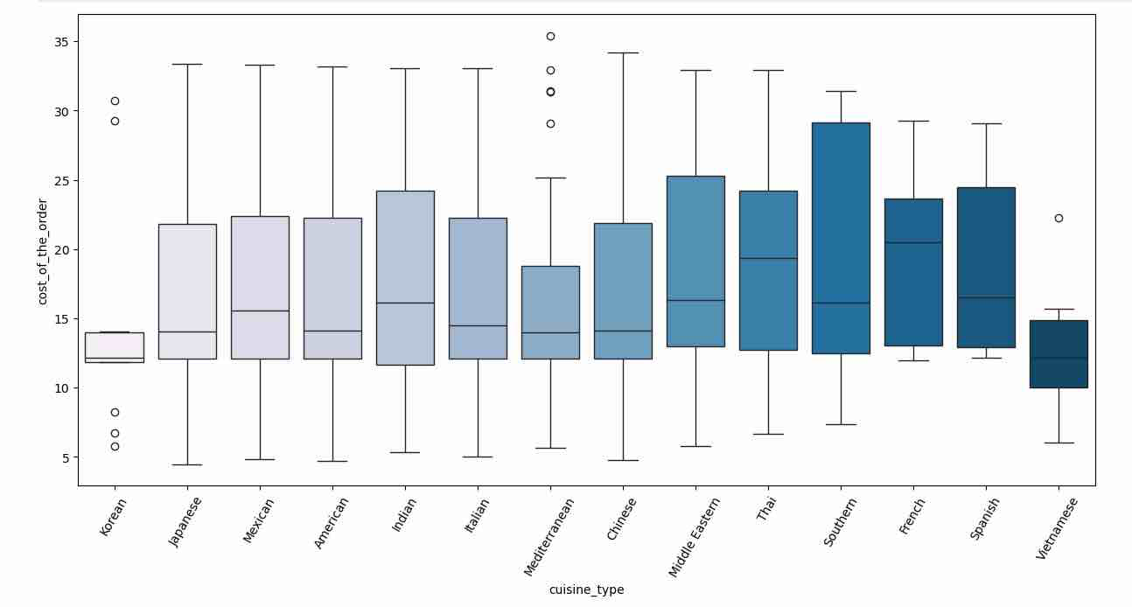
Question 12: Perform a multivariate analysis to explore relationships between the important variables in the dataset. (It is a good idea to explore relations between numerical variables as well as relations between numerical and categorical variables) [10 marks]
The boxplot reveals clear variation in order cost across cuisine types. French cuisine exhibits one of the highest median costs, followed by Southern and Thai cuisines, suggesting a premium pricing structure. American, Japanese, Italian, and Mexican cuisines fall within a moderate price range, indicating strong mid-market positioning. Vietnamese cuisine shows a comparatively lower median cost. The presence of outliers and varying interquartile ranges indicates price diversity within cuisines. These differences suggest that cuisine type plays a significant role in pricing strategy and revenue generation, with certain cuisines likely contributing higher per-order revenue.

Slide 25
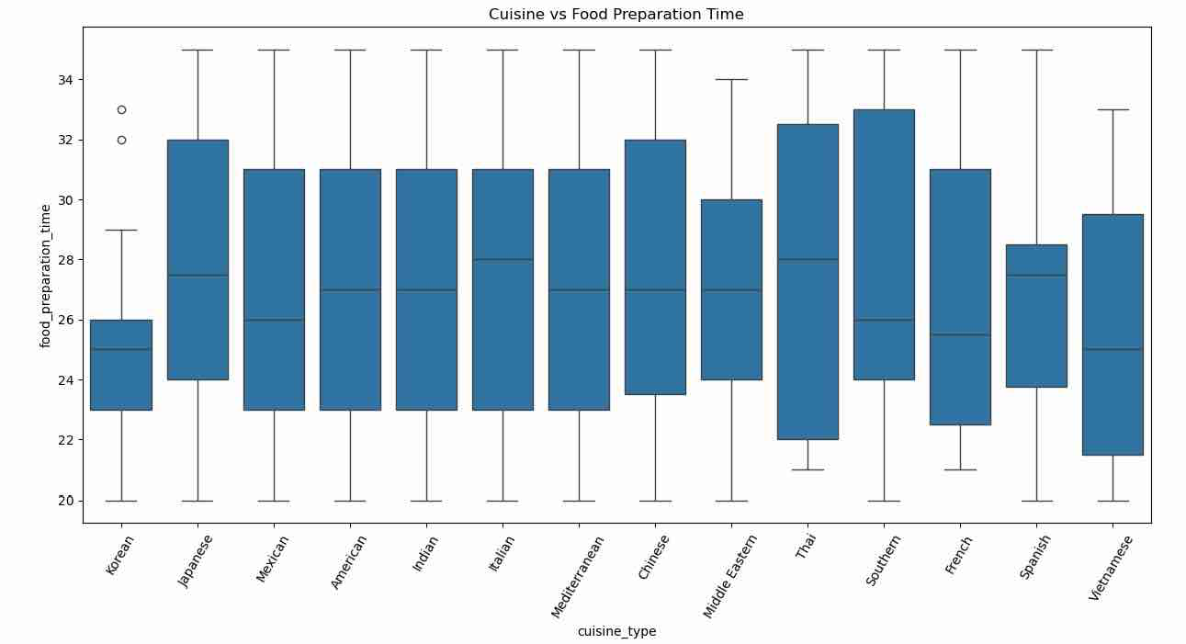
The food preparation time is relatively consistent across cuisine types, with most median values ranging between 25 and 28 minutes. Italian and Thai cuisines show slightly higher preparation times, while Vietnamese and Korean cuisines appear slightly faster. Overall, variability is limited, indicating standardized kitchen operations across restaurants. Cuisine type does not appear to significantly impact preparation time.

Slide 26
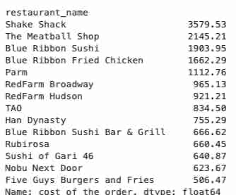
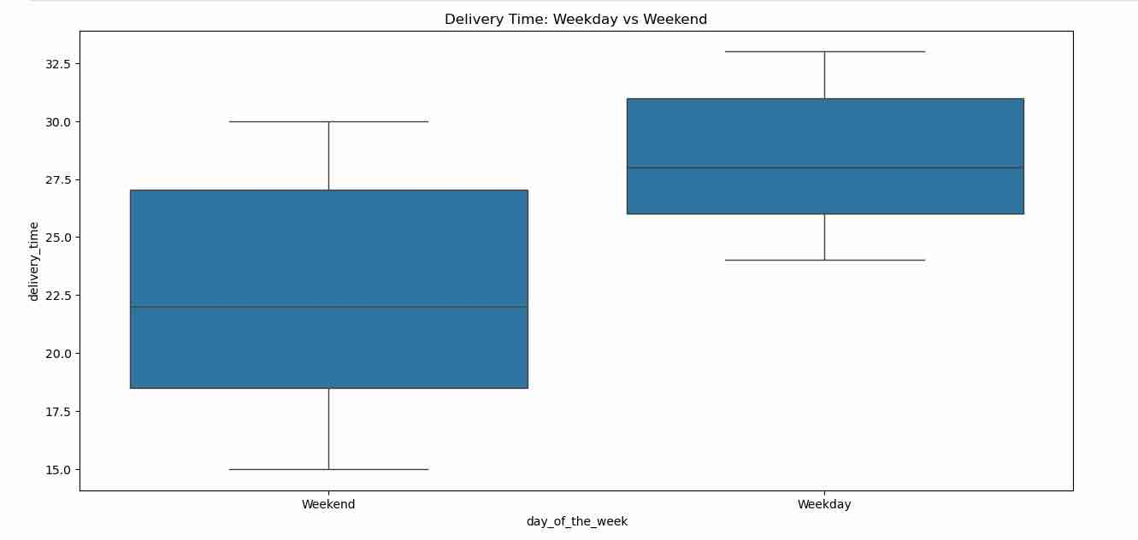
Cuisine vs. Food Preparation Time: Daty of the Week vs Delivery Time
Revenue analysis shows that Shake Shack generates the highest total revenue (3579.53 dollars), significantly outperforming other restaurants. The Meatball Shop and Blue Ribbon Sushi follow with 2145.21 dollars and 1903.95 dollars respectively. The revenue distribution indicates strong concentration among a few high-performing restaurants, suggesting that a small subset of restaurants drives a large portion of total platform revenue. Strengthening partnerships and promotional visibility for these restaurants could further enhance overall profitability.
The boxplot shows that median delivery time is higher on weekdays (28 minutes) compared to weekends (22 minutes). This suggests that weekday deliveries may be affected by higher traffic congestion or operational demand. FoodHub may consider increasing delivery resources during weekdays to improve efficiency and reduce delays.

Slide 27
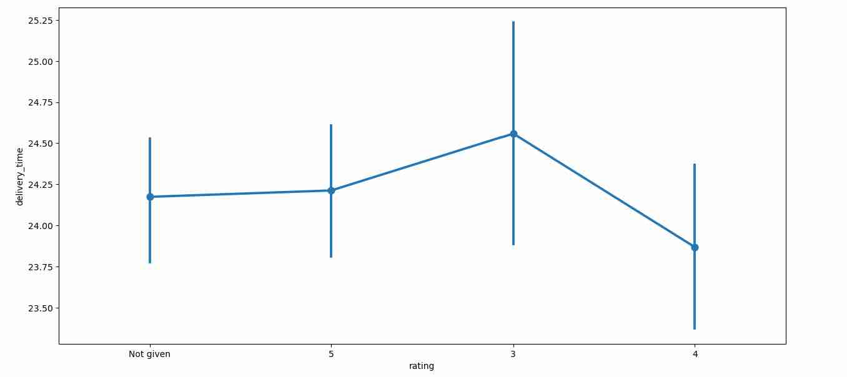
Rating vs Delivery Time
The relationship between rating and delivery time shows only minor variation across rating levels. Although slightly higher delivery times are observed for lower ratings, the overall differences are small. This suggests that delivery time alone may not be the primary driver of customer satisfaction, and other factors such as food quality and service experience likely play a more significant role.

Slide 28
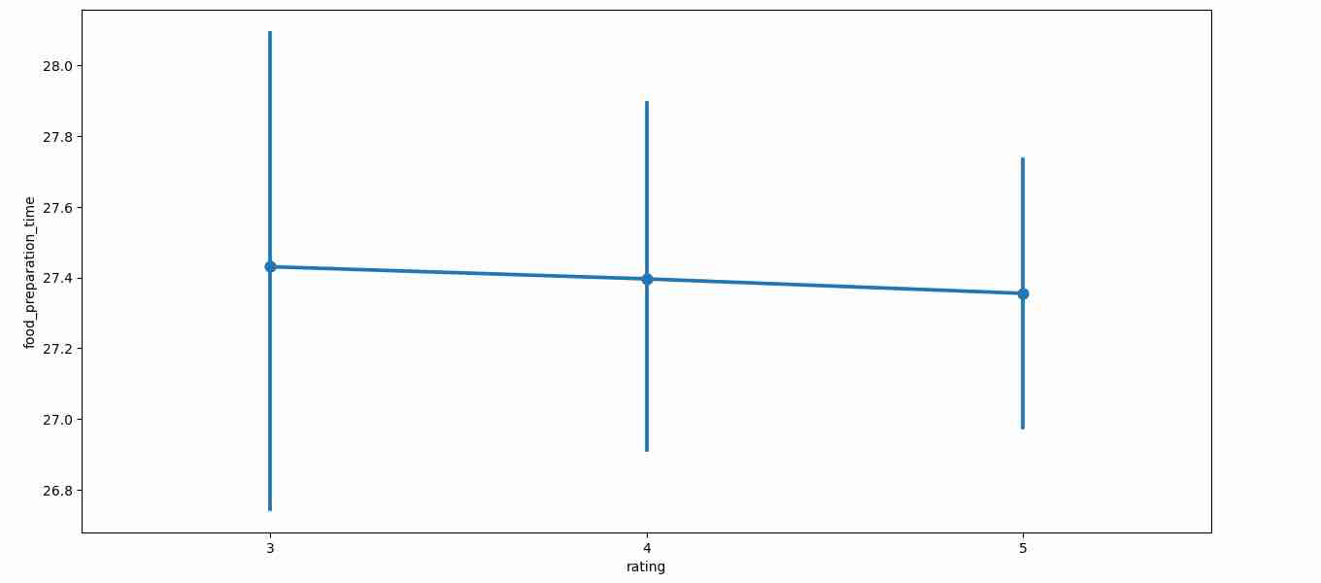
Rating vs. Food Prep Time
The relationship between rating and food preparation time shows minimal variation across rating levels. The average preparation time remains approximately 27 minutes for ratings 3, 4, and 5, with overlapping confidence intervals. This indicates that preparation time does not significantly influence customer ratings. Other factors such as food quality, delivery experience, and order accuracy may play a more important role in determining customer satisfaction.

Slide 29
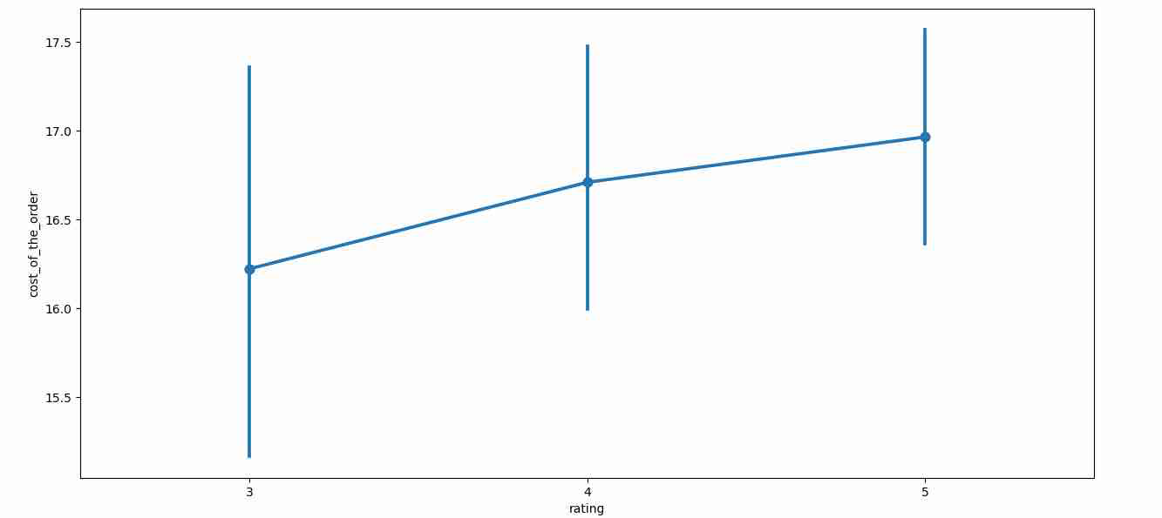
Rating vs. Cost of the Order
The relationship between rating and cost of the order shows a slight positive trend. Orders with higher ratings tend to have marginally higher average costs, with rating 5 orders averaging approximately 17 dollars compared to 16.2 dollars for rating 3. This suggests that higher-priced meals may be associated with slightly better customer satisfaction, possibly reflecting perceived food quality or restaurant reputation. However, the difference is modest, indicating that cost alone does not strongly determine ratings.

Slide 30
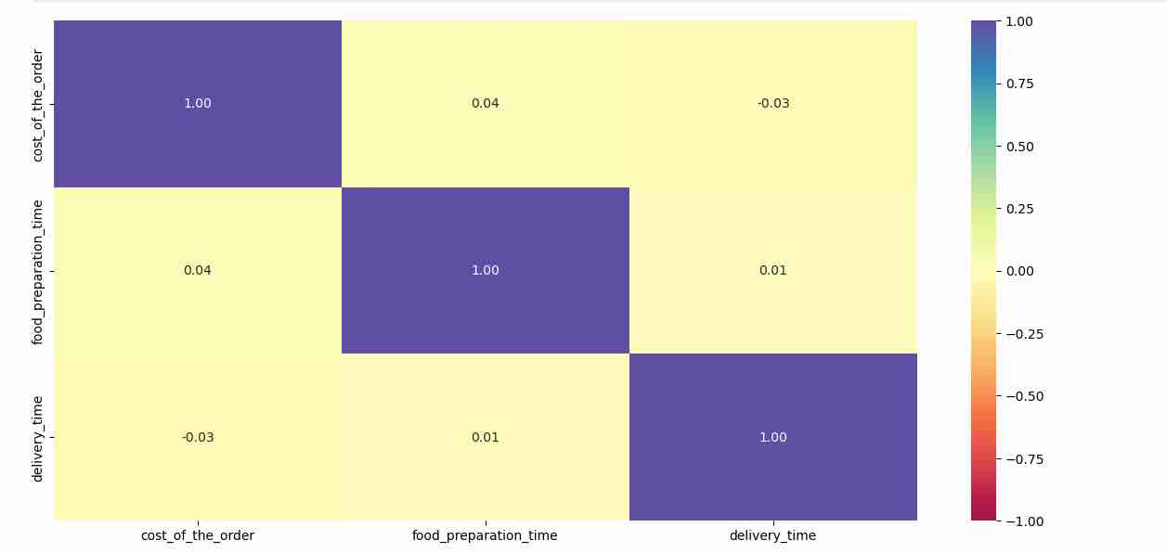
Correlation Amond Variables
The correlation analysis reveals very weak relationships among cost, food preparation time, and delivery time. The correlation between cost and preparation time (0.04) and between preparation and delivery time (0.01) are close to zero, indicating minimal linear association. Similarly, the correlation between cost and delivery time (-0.03) is negligible. These findings suggest that pricing, preparation time, and delivery time operate largely independently, and no strong linear relationships exist among these operational variables.

Slide 31
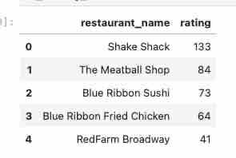
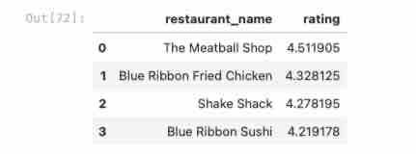
Question 13: The company wants to provide a promotional offer in the advertisement of the restaurants. The condition to get the offer is that the restaurants must have a rating count of more than 50 and the average rating should be greater than 4. Find the restaurants fulfilling the criteria to get the promotional offer. [3 marks]
Based on the promotional criteria (rating count greater than 50 and average rating above 4), four restaurants qualify: The Meatball Shop (4.51), Blue Ribbon Fried Chicken (4.33), Shake Shack (4.28), and Blue Ribbon Sushi (4.22). These restaurants demonstrate both strong customer engagement and high satisfaction levels. Featuring these restaurants in promotional advertisements is likely to enhance customer trust, drive increased order volume, and maximize platform revenue.
Shake Shack has the highest number of ratings (133), followed by The Meatball Shop (84), Blue Ribbon Sushi (73), and Blue Ribbon Fried Chicken (64). These restaurants exceed the minimum rating count threshold of 50. After applying the second condition of average rating greater than 4, four restaurants qualify for the promotional offer.

Slide 32
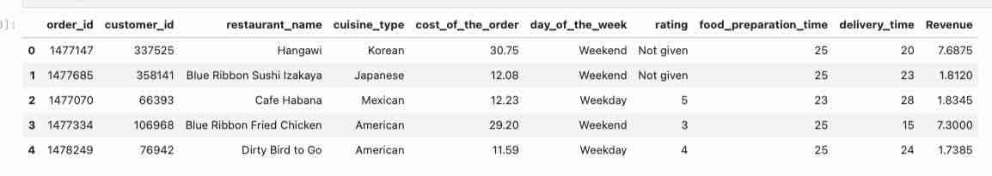
Question 14: The company charges the restaurant 25% on the orders having cost greater than 20 dollars and 15% on the orders having cost greater than 5 dollars. Find the net revenue generated by the company across all orders. [3 marks]
After applying the commission structure (25% on orders above 20 dollars and 15% on orders above 5 dollars), the total net revenue generated across all orders is approximately 6,166.30 dollars . This indicates that commission-based revenue is strongly influenced by higher-value orders. Since nearly 30% of orders exceed 20 dollars, promoting premium-priced meals could significantly increase overall profitability. On average, the company earns approximately 3.25 per dollarsorder, highlighting the importance of both order volume and order value in revenue generation.

Slide 33
Question 15: The company wants to analyze the total time required to deliver the food. What percentage of orders take more than 60 minutes to get delivered from the time the order is placed? (The food has to be prepared and then delivered.)[2 marks]
Approximately 10.54% of orders take more than 60 minutes from the time the order is placed to delivery. This means that about 1 in 10 customers experience a delivery time exceeding one hour. While the majority of orders (nearly 90%) are delivered within 60 minutes, the remaining delayed segment may negatively impact customer satisfaction. Reducing these longer delivery cases could improve service reliability and enhance overall customer experience.

Slide 34

Question 16: The company wants to analyze the delivery time of the orders on weekdays and weekends. How does the mean delivery time vary during weekdays and weekends? [2 marks]
The mean delivery time is approximately 28 minutes on weekdays and 22 minutes on weekends. This indicates that weekday deliveries take about 6 minutes longer on average compared to weekend deliveries. The difference may be due to higher traffic congestion, business-hour demand, or operational constraints during weekdays. Improving delivery efficiency during weekdays could enhance customer satisfaction and reduce service delays.

Slide 35
Question 17: What are your conclusions from the analysis? What recommendations would you like to share to help improve the business? (You can use cuisine type and feedback ratings to drive your business recommendations.) [6 marks]
Conclusions:
Demand is Highly Concentrated on Weekends: Approximately 71% of total orders occur on weekends, indicating that customer demand significantly increases during this period. Weekend demand is more than twice that of weekdays.
Revenue and Order Volume Are Concentrated Among Few Restaurants: The top 5 restaurants contribute approximately 33% of total orders. Shake Shack alone accounts for over 11% of all orders and generates the highest revenue ($3,579.53). This indicates strong brand dominance and demand concentration.
Cuisine Preferences Are Strongly Focused: American cuisine accounts for 30.7% of weekend orders, followed by Japanese cuisine at 24.8%. Together, these two cuisines represent over 55% of weekend demand. The top four cuisines make up approximately 83% of weekend orders, indicating significant customer preference clustering.
High Customer Satisfaction Levels: Among rated orders, 84% are rated 4 or 5 stars, indicating strong overall satisfaction. However, 38.8% of orders are not rated, limiting feedback insights.
Delivery Performance Differences: mean delivery time = 24.16 minutes, weekday delivery time (28 min) is significantly longer than weekend delivery time (22 min), 10.54% of orders exceed 60 minutes total service time. This suggests operational inefficiencies during weekdays and a small but meaningful delayed-delivery segment.
Limited Correlation Between Operational Variables: Cost, preparation time, and delivery time show negligible correlation. This suggests pricing and operational speed operate largely independently.
Recommendations:
Increase Weekend Operational Capacity: Since demand is highest on weekends then it is recommended to increase delivery staffing during these times, offer weekend premium promotions, and highlight top-performing cuisines (American & Japanese).
Improve Weekday Delivery Efficiency: Weekday delivery is 6 minutes slower on average and it is reccommended to optimize routing algorithms, increase driver availability during peak weekday hours, and implement traffic-based dispatching.
Target High-Value Orders: Since ~29% of orders exceed $20 and generate higher commission and it is recommeneded to promote premium meal bundles, offer loyalty incentives for high-spending customers, and upsell add-ons during checkout.
Strengthen Partnerships with Top Restaurants: Top restaurants generate a disproportionate share of revenue and it is recommended to offer featured placement in the app, run co-branded promotions, and provide advertising discounts for high-rated restaurants.
Encourage Customer Ratings: With 38.8% of orders unrated it is recommended that retauranuts provide small discounts for leaving feedback, send post-delivery rating reminders, and gamify rating participation. More feedback improves service optimization and customer trust.
Reduce Long Delivery Times (>60 Minutes): Since 10.5% of orders exceed 60 minutes it is recommended to identify route bottlenecks Analyze peak-time congestion, and monitor restaurants with consistently high total_time. Reducing long-delivery cases can significantly improve satisfaction.

